Slide 1
GLEEY AUTOS REPORT
Car Price Predictions

Slide 2
Objective
To predict the factors on which the pricing of cars depends on in the Nigerian market.

Slide 3
Relationship of some predictors with Price.

Slide 4
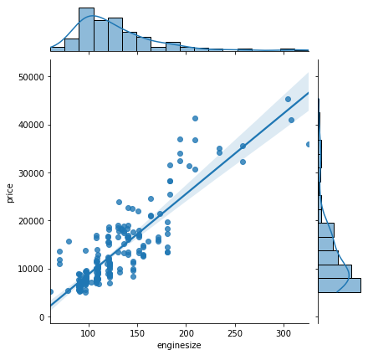
Engine-size and Price
There is a strong positive correlation(0.87) between Engine-size and Price. The feature is one to consider during price prediction.

Slide 5
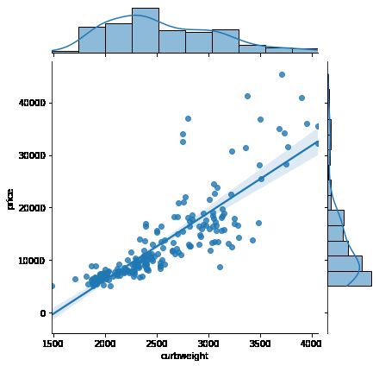
Curb-weight and Price
There is a strong positive correlation between curb-weight and price (0.84). Curb-weight is another feature to look out for in the prediction of car price.

Slide 6
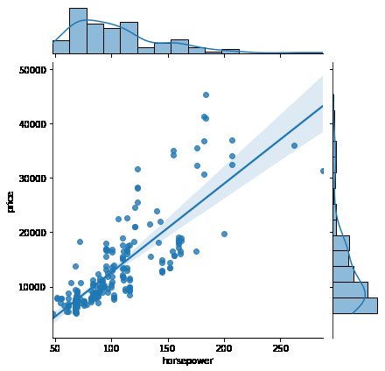
Horsepower and Price
There is a strong positive correlation between Horsepower and Price (0.81) , this is also a feature to look out for in the prediction of price.

Slide 7
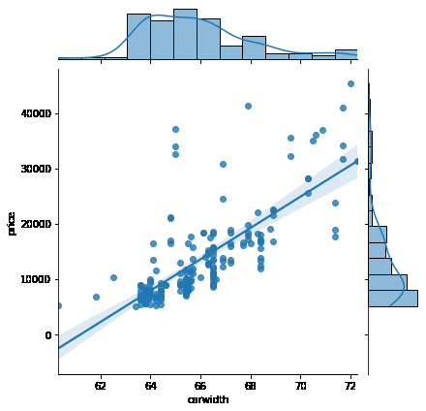
Car-Width and Price
There is a positive correlation between car-width and Price (0.76). Car width is also another feature to look out for.

Slide 8
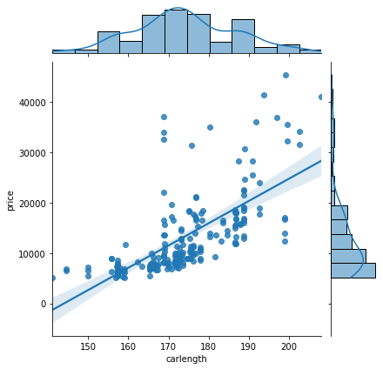
Car-Length and Price
A weak positive correlation of 0.68 was observed between car length and price. This implies car length only weakly affect the price of car.

Slide 9
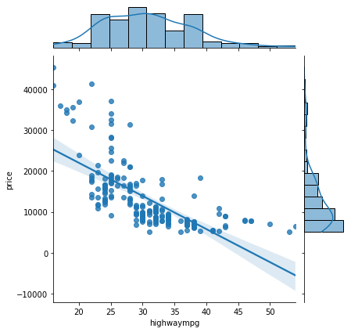
Highway-mpg and Price
Highway-mpg and Price showed a negative correlation this means as the values of the highway mpg increases the price decreases hence the Highway-mpg should be taken considered of when setting the price, the price of cars with lower values of high-way mpg show be higher.

Slide 10
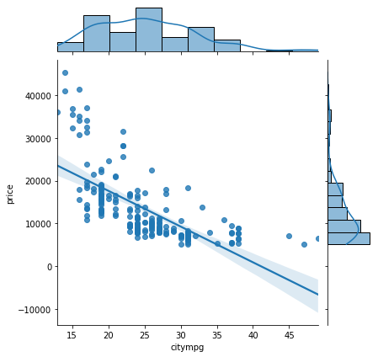
City-mpg and Price
There is a negative correlation between City-Mpg and Price, this also implies that as the values of city-mpg increases the price should decrease and vice-versa.

Slide 11
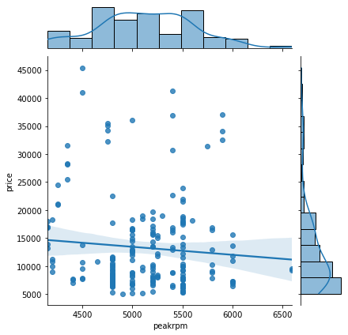
Peak-rpm and Price
The Peak-rpm feature has a very weak negative correlation with Price, this correlation is near zero with is no correlation(-0.085), the feature should not be considered when fixing the price.

Slide 12
Feature Importance

Slide 13
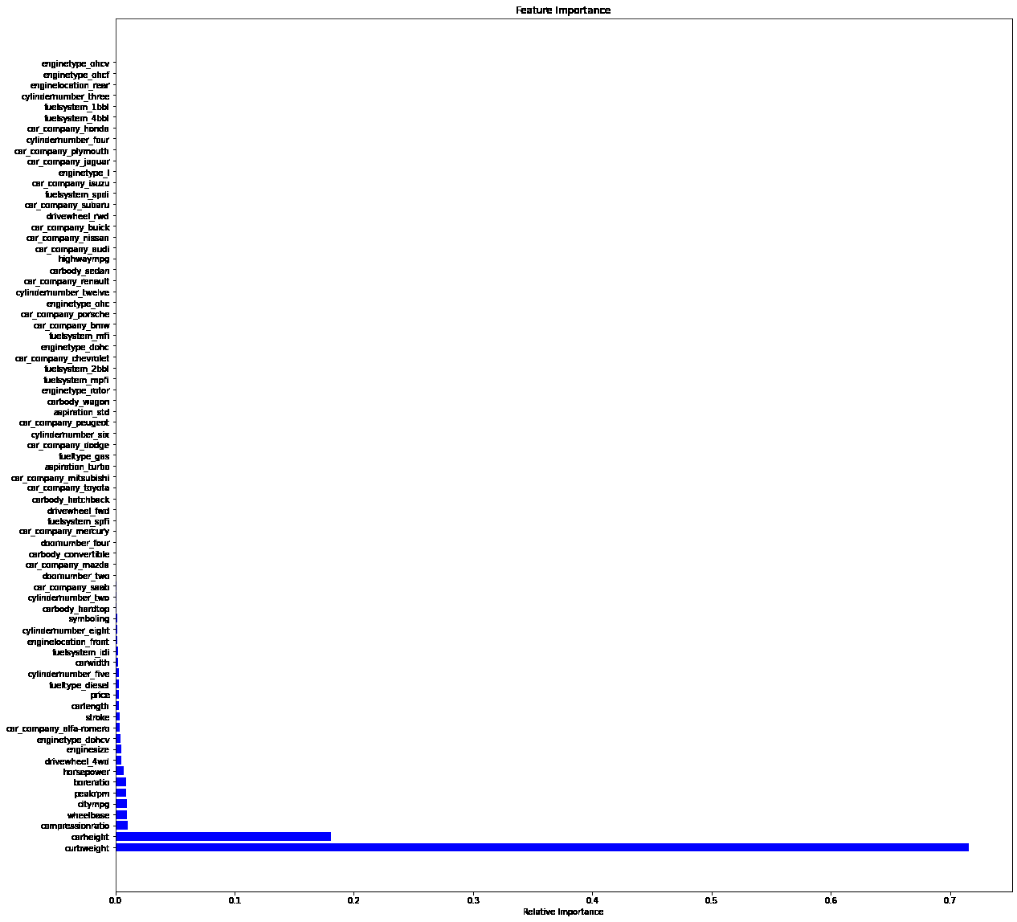
Feature Importance
This graph shows the important features necessary for predictions are Bore ratio, Peakrpm, Citympg, Wheelbase, Compression ratio, Car weight, Car height.

Slide 14
Machine Learning
Regression models employed in the prediction are:
Linear Regression
Random Forest Regressor
Elastic Net

Slide 15
Linear regression and Random forest regressor, gave better R- score than the Elastic Net.
I will recommend the use of the Random Forest Regressor as it gave a normal residual plots.
The outliers should be treated and the feature importance should be considered while predicting the price

Slide 16
Recommendations
Cars with four doors, that uses gas, STD aspirators, sedan car body, forward wheel, front engine location, Mpfi fuel system should be imported and assembled the most as these are the most bought cars from our Univariate analysis.

Slide 17
THANK YOU FOR YOUR TIME

